Slide 1
The Badí‘ Calendar
A brief introduction
Version 1.1
Last updated on ‘Alá’ 3, 171
By Glen Little with help from members of the Wilmette Institute “Badí‘ Calendar” online course

Slide 2
Where did it come from?
The Báb created the Badí‘ (“wondrous”) calendar and established all its major elements.
Bahá’u’lláh resolved some ambiguities.
The Universal House of Justice defined the final details so that it can be uniformly used by the entire Bahá'í world.¹

Slide 3
What does the calendar look like?
Each year has 19 months of 19 days.
The days of each month have the same names as the months of the year.
The Báb named them according to the verses of the “Prayer of Glory” — an early Islamic prayer.²
The following slide lists the months, along with a translation of each.

Slide 4
Names of the Badí‘ months/days
1 Bahá (Splendour)
2 Jalál (Glory)
3 Jamál (Beauty)
4 ‘Azamat (Grandeur)
5 Núr (Light)
6 Raḥmat (Mercy)
7 Kalimát (Words)
8 Kamál (Perfection)
9 Asmá’ (Names)
10 ‘Izzat (Might)
11 Mashíyyat (Will)
12 ‘Ilm (Knowledge)
13 Qudrat (Power)
14 Qawl (Speech)
15 Masá’il (Questions)
16 Sharaf (Honour)
17 Sulṭán (Sovereignty)
18 Mulk (Dominion)
19 ‘Alá’ (Loftiness)

Slide 5
When does the year start?
The year begins on the day in Tehran (Iran) when the vernal equinox occurs on Earth — the start of spring in the northern hemisphere. The exact times are pre-calculated and published years in advance.
The first day of the year is called Naw-Rúz (“New Day”) and is the first Holy Day in the Bahá'í Faith.

Slide 6
When did the calendar begin?
Bahá’u’lláh fixed year 1 of the calendar to be the year when the Báb made His Declaration.
The first day of the first year coincided with the Gregorian calendar date of March 21, 1844.

Slide 7
How many days are in the year?
19 months of 19 days totals 361 days.
However, a solar year currently has approximately 365.2425 days.
An extra 4 or 5 days are added between months 18 and 19, and are called “Ayyám-i-Há” (“Days of Há”, Há = 5).
The length of Ayyám-i-Há is determined according to when the next Naw-Rúz occurs.

Slide 8
How are years grouped?
The Báb grouped years into sets of 19 and called the set a “Váhid” (“Unity”). He gave each year in the Váhid a unique name.
He also grouped Váhids in sets of 19 and called the set a “Kull-i-Shay’” (“All Things”).
Year 172 (from March 2015 AD) is the first year of the 10th Váhid of the first Kull-i-Shay’.

Slide 9
Groups of Nineteen
19 days
19 months
19 years
19 Váhids
→ 1 month
→ 1 year
→ 1 Váhid
→ 1 Kull-i-shay’ (361 years)

Slide 10
Are there other groupings?
Days are grouped in weeks, and each day in a week is given a name. The first day of the week corresponds to Saturday.
The Báb put the 19 months into groups of 3, 4, 6 and 6. This is explained as:³
The first three months represent the fire of God
The next four, the air of eternity
The following six, the water of Divine Unity
The last six, the sacred realm of the earth

Slide 11
When does the day start?
In the Bahá'í Faith, similar to many other religions, the day starts at sunset when the sun disappears below the horizon.
The time of sunset is pre-calculated using modern astronomical formulas and is usually stated using standard clocks that start at midnight, respecting the local time zone.

Slide 12
When are the Bahá'í Holy Days?
There are 11 Bahá'í Holy Days, and on 9 of them, work and school are to be suspended.
Each is celebrated annually on the exact solar anniversary of the event being remembered — except for the birthdays of the Báb and Bahá’u’lláh.

Slide 13
When are the birthdays of the Báb and Bahá’u’lláh? (part 1)
In the Gregorian calendar...
Bahá’u’lláh was born on 12 November 1817
The Báb was born on 20 October 1819
In the Islamic calendar used in Iran…
Bahá’u’lláh was born on Muharram 2, 1233
The Báb was born on Muharram 1, 1235
Bahá’u’lláh referred to these days as “the twin days” and said that they are “accounted as one in the sight of God.”⁴

Slide 14
When are the birthdays of the Báb and Bahá’u’lláh? (part 2)
The Universal House of Justice has decided that they will be observed on the first and the second day following the 8th new moon after Naw-Rúz (as they occurred in 1817 and 1819⁵).
As a result, the Twin Birthdays are always celebrated some time during Mashíyyat, 'Ilm or Qudrat. The exact dates are pre-calculated and published years in advance.

Slide 15
What other Holy Days changed?
The Universal House of Justice decided to “set aside certain discrepancies in the historical record” for these two days:
The Declaration of the Báb is now observed on 'Azamat 8, formerly on 'Azamat 7 (May 22/23).
The Martyrdom of the Báb is now observed on Raḥmat 17, formerly on Raḥmat 16 (July 8/9).

Slide 16
The Bahá'í Holy Days
Naw-Rúz
First Day of Riḍván
Ninth Day of Riḍván
Twelfth Day of Riḍván
Declaration of the Báb
Ascension of Bahá’u’lláh
Martyrdom of the Báb
Birth of the Báb
Birth of the Bahá’u’lláh
Day of the Covenant
Ascension of ‘Abdu’l-Bahá
1 Bahá
13 Jalál
2 Jamál
5 Jamál
8 ‘Azamat
13 ‘Azamat
17 Raḥmat
(Twin Birthday)
(Twin Birthday)
4 Qawl
6 Qawl

Slide 17
Is the Badí‘ calendar independent?
Until the recent decisions by the Universal House of Justice, the Gregorian calendar’s leap years were followed, and in some countries, the Islamic calendar was used to place the Twin Birthdays.
The Badí‘ calendar is now independent of all other calendar systems.

Slide 18
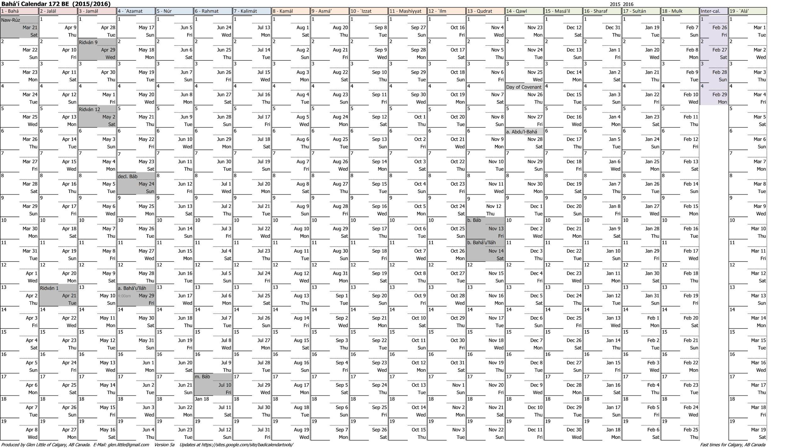
Visualizing a year (version 1)
Year 172 with Holy Days and Ayyám-i-Há

Slide 19
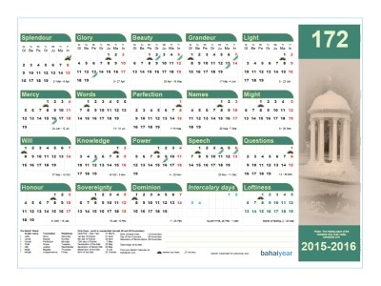
Visualizing a year (version 2)
From bahaicalendars.com

Slide 20
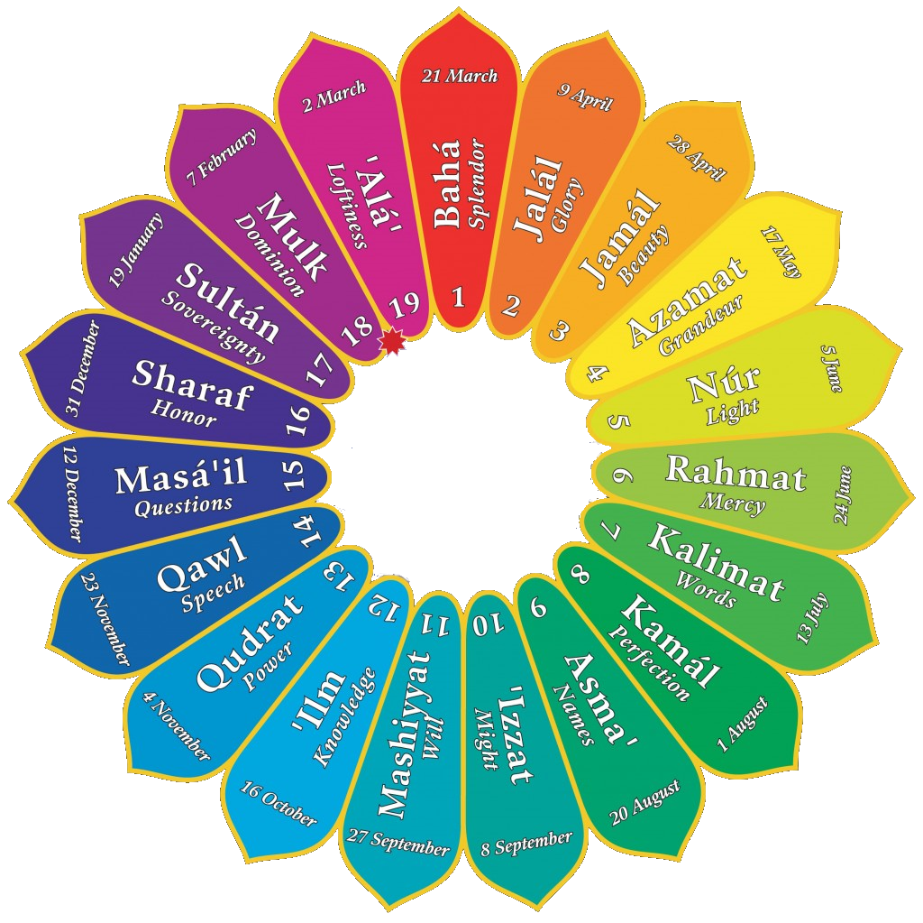
Visualizing a year (version 3)
(The Gregorian dates shown here were for years before 172. Starting in 172, the dates vary each year.)

Slide 21
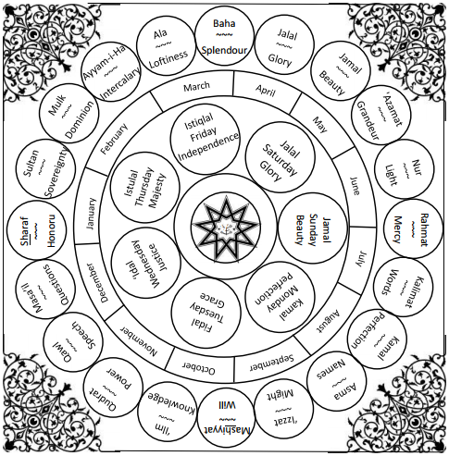
Visualizing a year (version 4)
From http://athomewithmommaskyla.blogspot.com.au

Slide 22
More Information
Some useful web sites that can calculate days and calendars for any year for your location:
Badí‘ Calendar Calculator
Feasts & Holy Days
More information and tools are listed on the Badí‘ Calendar Tools page.

Slide 23
References
10 July 2014 Message to the Bahá'ís of the World, Universal House of Justice (link)
“Du’a al-Baha’” by Imám Báqir (link)
“Gate of the Heart” by Nader Saiedi (link)
“Kitáb-i-Aqdas”, paragraph 110 and note 138 (link)
Islamic calendars for 1817 and 1819.

